Slide 1
Dijkstra’s Algorithm
Preeti Garg
KIET Ghaziabad

Slide 2
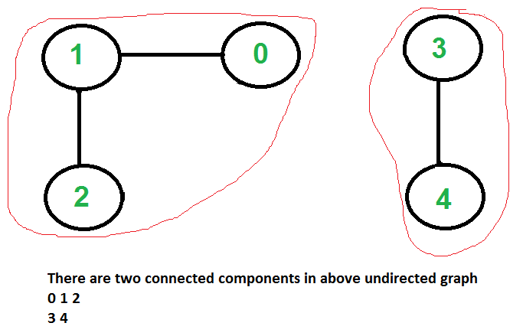
Connected Components
A connected component, of an undirected graph is a sub graph in which any two vertices are connected to each other by paths and which is connected to no additional vertices in the super graph.

Slide 3
Transitive Closure of Graph
Given a directed graph, find out if a vertex j is reachable from another vertex i for all vertex pairs (i, j) in the given graph.
Here reachable mean that there is a path from vertex i to j. The reach-ability matrix is called the transitive closure of a graph.
Transitive closure is:
1 1 1 1
1 1 1 1
1 1 1 1
0 0 0 1

Slide 4
Shortest Path Problems
What is shortest path ?
  shortest length between two vertices for an unweighted graph:
  smallest cost between two vertices for a weighted graph:
B
B
210
A
A
450
60
190
C
unweighted graph
C
weighted graph
200
130
D
D
E
E

Slide 5

Single-Source Shortest Path Problem
Single-Source Shortest Path Problem - The problem of finding shortest paths from a source vertex v to all other vertices in the graph.

Slide 6


Applications
- Maps (Map Quest, Google Maps)
- Routing Systems

Slide 7
Dijkstra's algorithm
Dijkstra's algorithm - is a solution to the single-source shortest path problem in graph theory.
Works on both directed and undirected graphs. However, all edges must have nonnegative weights.
Input: Weighted graph G={E,V} and source vertex v∈V, such that all edge weights are nonnegative
Output: Lengths of shortest paths (or the shortest paths themselves) from a given source vertex v∈V to all other vertices

Slide 8
Example: Initialization
Distance(source) = 0
0
∞
Distance (all vertices but source) = ∞
A
2
B
4
1
3
10
∞
C
2
D
2
E
∞
5
8
∞
4
6
F
1
G
∞
∞
Pick vertex in List with minimum distance.

Slide 9
Example: Update neighbors' distance
0
2
A
2
B
4
1
3
10
∞
C
2
D
2
E
∞
5
8
1
4
6
Distance(B) = 2
F
1
G
Distance(D) = 1
∞
∞

Slide 10
Example: Remove vertex with minimum distance
0
2
A
2
B
4
1
3
10
∞
C
2
D
2
E
∞
5
8
1
4
6
F
1
G
∞
∞
Pick vertex in List with minimum distance, i.e., D

Slide 11
Example: Update neighbors
0
2
A
2
B
4
1
3
10
3
C
2
D
2
E
3
5
8
1
4
6
Distance(C) = 1 + 2 = 3 Distance(E) = 1 + 2 = 3 Distance(F) = 1 + 8 = 9 Distance(G) = 1 + 4 = 5
F
1
G
9
5

Slide 12
Example: Continued...
Pick vertex in List with minimum distance (B) and update neighbors
0
2
A
2
B
4
1
3
10
3
C
2
D
2
E
3
5
8
1
4
6
Note : distance(D) not updated since D is already known and distance(E) not updated since it is larger than previously computed
F
1
G
9
5

Slide 13
Example: Continued...
Pick vertex List with minimum distance (E) and update neighbors
0
2
A
2
B
4
1
3
10
3
C
2
D
2
E
3
5
8
1
4
6
F
1
G
No updating
9
5

Slide 14
Example: Continued...
Pick vertex List with minimum distance (C) and update neighbors
0
2
A
2
B
4
1
3
10
3
C
2
D
2
E
3
5
8
1
4
6
Distance(F) = 3 + 5 = 8
F
1
G
8
5

Slide 15
Example: Continued...
Pick vertex List with minimum distance (G) and update neighbors
0
2
A
2
B
4
1
3
10
3
C
2
D
2
E
3
5
8
1
4
6
F
1
G
Previous distance
6
5
Distance(F) = min (8, 5+1) = 6

Slide 16
Example (end)
0
2
A
2
B
4
1
3
10
3
C
2
D
2
E
3
5
8
1
4
6
F
1
G
6
5
Pick vertex not in S with lowest cost (F) and update neighbors

Slide 17

Another Example

Slide 18

Another Example

Slide 19

Another Example

Slide 20

Another Example

Slide 21

Another Example

Slide 22

Another Example

Slide 23

Another Example

Slide 24

Another Example

Slide 25

Another Example

Slide 26

Dijkstra’s Pseudo Code
Graph G, weight function w, root s
relaxing edges

Slide 27
Time Complexity: Using List
The simplest implementation of the Dijkstra's algorithm stores vertices in an ordinary linked list or array
  Good for dense graphs (many edges)
|V| vertices and |E| edges
Initialization O(|V|)
While loop O(|V|)
  Find and remove min distance vertices O(|V|)
Potentially |E| updates
    Update costs O(1)
Total time O(|V²| + |E|) = O(|V²| )

Slide 28
Time Complexity: Priority Queue
For sparse graphs, (i.e. graphs with much less than |V²| edges) Dijkstra's implemented more efficiently by priority queue
Initialization O(|V|) using O(|V|) buildHeap
While loop O(|V|)
    Find and remove min distance vertices O(log |V|) using O(log |V|) deleteMin
Potentially |E| updates
    Update costs O(log |V|) using decreaseKey
Total time O(|V|log|V| + |E|log|V|) = O(|E|log|V|)
|V| = O(|E|) assuming a connected graph

Slide 29
Dijkstra’s Running Time
Dijkstra’s Pseudo Code
Extract-Min executed |V| time
Decrease-Key executed |E| time
Time = |V| T_{Extract-Min} + |E| T_{Decrease-Key}
T depends on different Q implementations
Q | T(Extract-Min) | T(Decrease-Key) | Total
array | O(V) | O(1) | O(V ²)
binary heap | O(lg V) | O(lg V) | O(E lg V)
Fibonacci heap | O(lg V) | O(1) (amort.) | O(V lgV + E)

Slide 30
Disadvantage of Dijkstra's Algorithm:
It does a blind search, so wastes a lot of time while processing.
It can't handle negative edges.
It cannot obtain the right shortest path.
We need to keep track of vertices that have been visited.

Slide 31
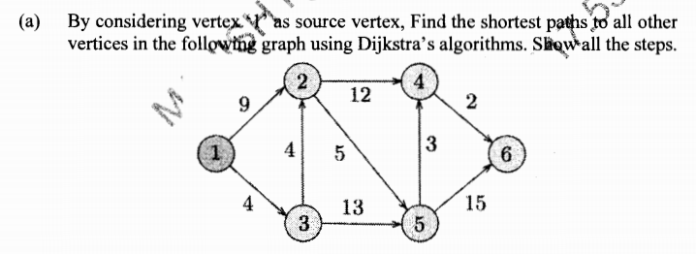
[2018-19]

Slide 32
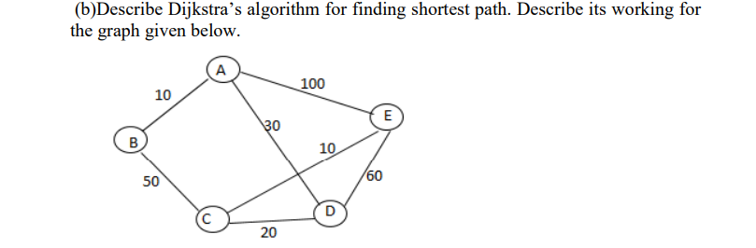
[2017-18]

